Slide 1
CALCULATOR JAVA APPLET

Slide 2
What is Applet?
Applet is a special type of program that is embedded in the webpage to generate the dynamic content. It runs inside the browser and works at client side.

Slide 3
Advantages of applet:
It works at client side so less response time.
Secured and data integration is one of the important advantage
It can be executed by browsers running under many platforms, including Linux, Windows, Mac Os etc.
Applets don’t have concordance objects with different versions of java.
It can also be resort as a real time application.
Applets cache quickly, that’s why there will be no latency in downloading of them.

Slide 4
disadvantages of applet:
Some browsers especially mobile browsers which are running on Apple IOS or Android don’t support applets run.
If a proxy server is applied to web access, than automatically installation and update of Java can be failed, that’s why applets can’t run with specific requirements unless Java is manually installed or updated.
Applets don’t access client-side resources, like files, operating system
Applets have to tag as trusted applets and they must be registered to APS
Applet cannot work with native methods.

Slide 5
Uses Of Applet:
Java Applets are usually used to add small, interactive components or enhancements to a webpage.
These may consist of buttons, scrolling text, or stock tickers, but they can also be used to display larger programs like word processors or games.
Java's incredible portability (the ability to run on many different operating systems and browsers) is what makes it ideal for use on the World Wide Web.

Slide 6
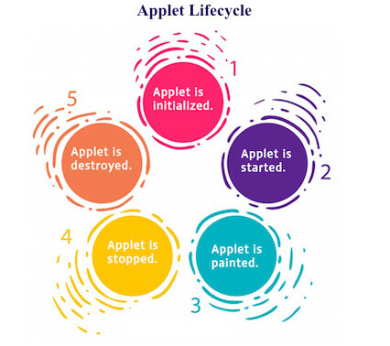
Applet Lifecycle

Slide 7
java.applet.Applet class:
public void init(): is used to initialized the Applet. It is invoked only once.
public void start(): is invoked after the init() method or browser is maximized. It is used to start the Applet.
public void stop(): is used to stop the Applet. It is invoked when Applet is stop or browser is minimized.
public void destroy(): is used to destroy the Applet. It is invoked only once.

Slide 8
java.awt.Component class:
public void paint(Graphics g): is used to paint the Applet. It provides Graphics class object that can be used for drawing oval, rectangle, arc etc.

Slide 9
Difference b/w java application and java Applet:
1)Applications are just like a Java programs that can be execute independently without using the web browser. | 1) Applets are small Java programs that are designed to be included with the HTML web document. They require a Java-enabled web browser for execution.
2) Application program requires a main function for its execution. | 2) Applet does not require a main function for its execution.
3) Applications can executes the programs from the local system. | 3) Applets cannot execute programs from the local machine.

Slide 10
Difference b/w java application and java Applet:
4) An application program is needed to perform some task directly for the user. | 4)An applet program is needed to perform small tasks or the part of it.5)
5)Java application programs have the full access to the local file system and network. | 5)Applets don’t have local disk and network access.
6) No security concerns are there. | 6) Requires security for the system as they are untrusted.

Slide 11


Slide 12
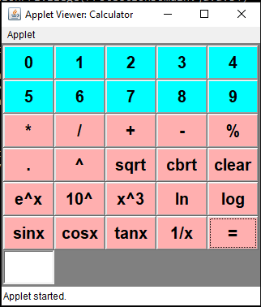
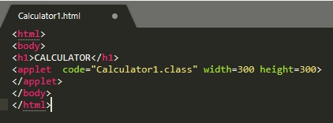


Slide 13
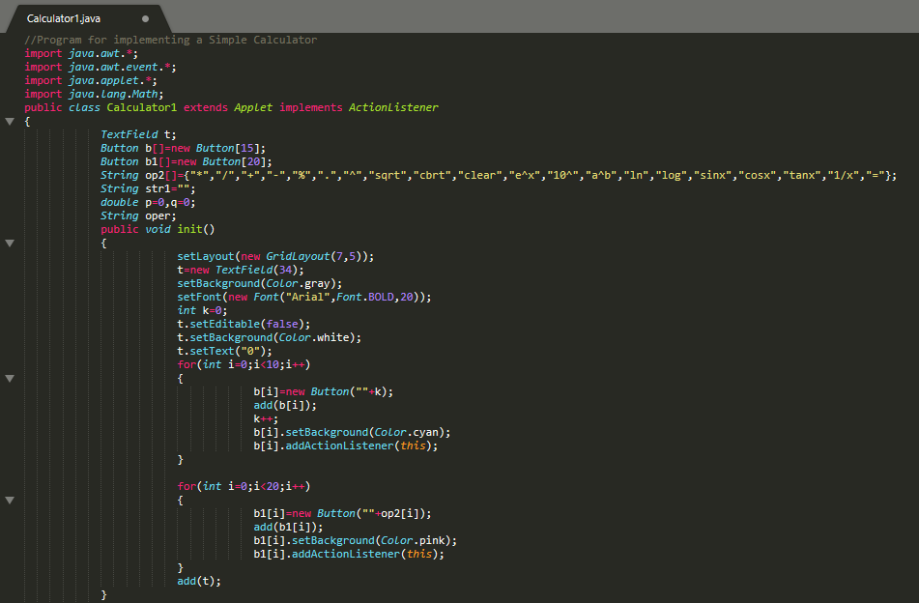

Slide 14
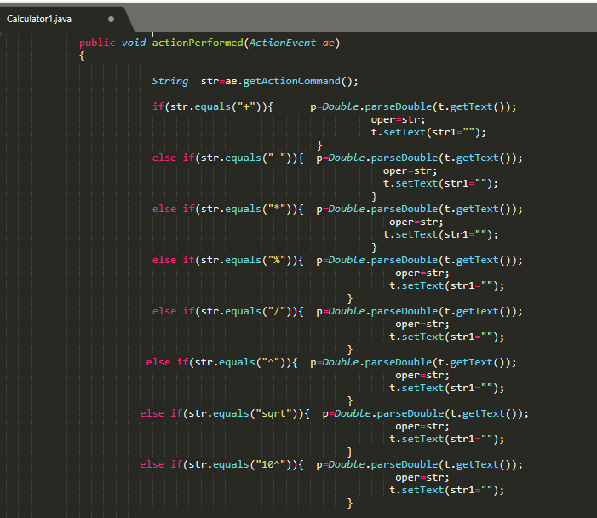
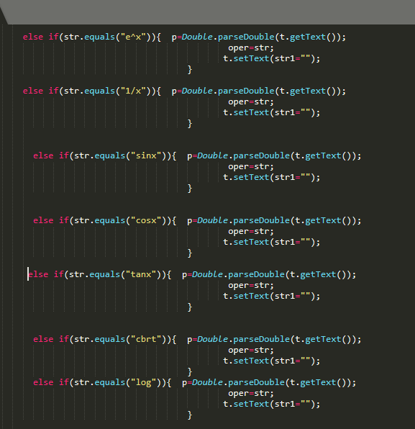

Slide 15
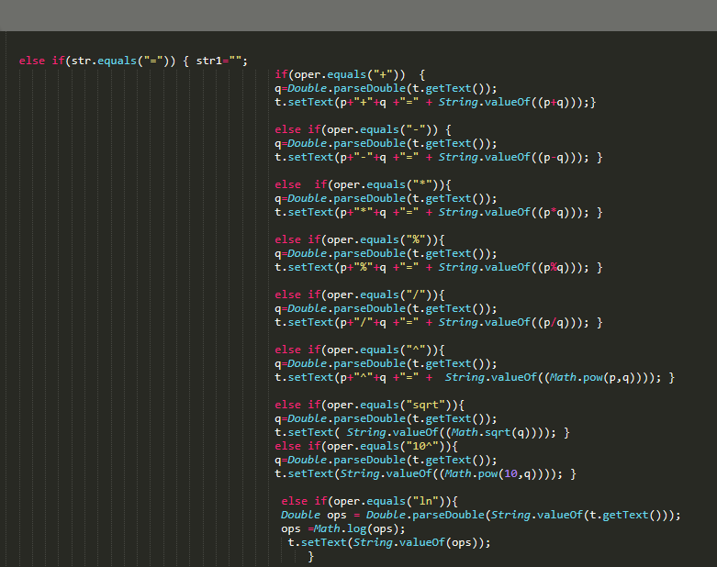
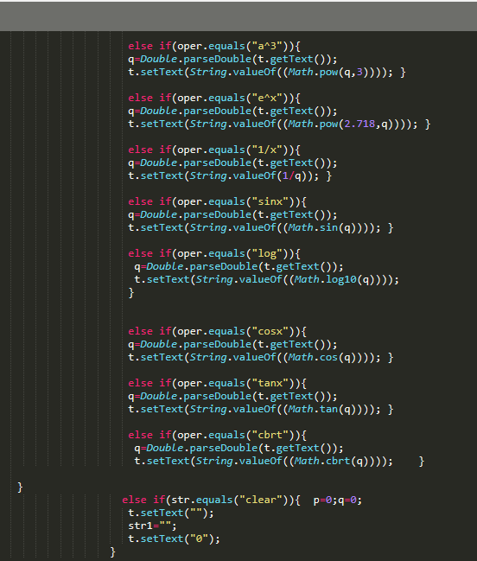

Slide 16
MEMBERS:
VATTIKUTI SHRAVYA
PREETHI REDDY MUDIREDDY
YENUMULA SRAVYA REDDY
NAGULAPATI KAVYA REDDY
BL.EN.U4CSE19140
BL.EN.U4CSE19110
BL.EN.U4CSE19154
BL.EN.U4CSE19091

